Slide 1
Early Detection in Parkinson’s using Voice Features
Miller Tracy

Slide 2

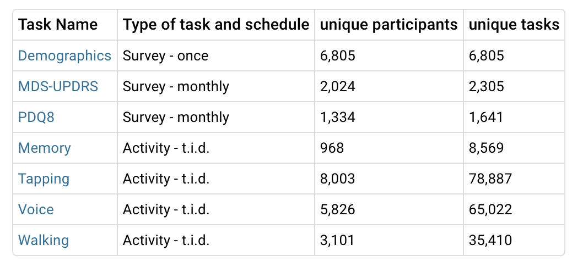
Dataset

Slide 3
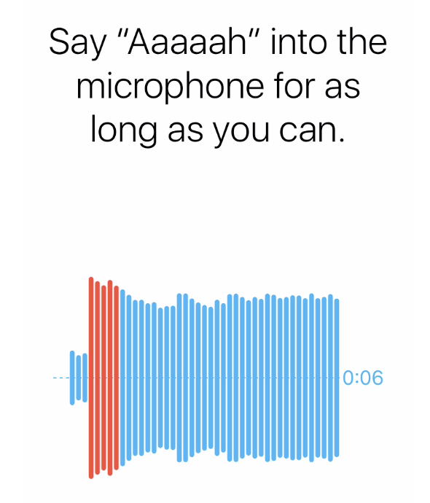
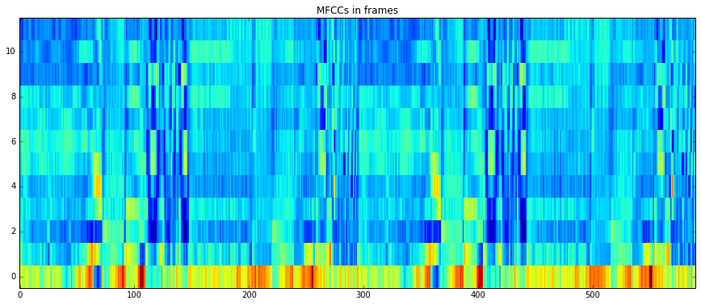
Idea
Voice feature extraction Classification
Clinical
Application
Diagnosis
“Mild Stage”
Early Detection
Diagnosis

Slide 4
Survey Screening
Screen out:
Surgeries
Medications for Controls
‘Are Caretaker’ Field for Parkinson’s group
Identify Parkinson’s Mild Stage group
MDS-UPDRS Part II (13 questions)
Martinez-Martin et al. - https://www.ncbi.nlm.nih.gov/pubmed/25466406
Scores 12/13 cutoff between Mild/Moderate
MDS-UPDRS < 10 - Mild Stage (10 questions)

Slide 5
Voice Sample Cleaning
Removed outliers (samples that were too long or too short)
2 std from mean
Screen for medication time point
Parkinson’s - [ ‘Immediately After’, ‘Don’t take meds’]
Controls - [‘Dont take meds’]

Slide 6
Voice Features
Py Audio Features
Description | Features
Zero Crossing Rate | 1
Energy | 1
Entropy of Energy | 1
Spectral Centroid | 1
Spectral Spread | 1
Spectral Entropy | 1
Spectral Flux | 1
Spectral Rolloff | 1
MFCCs | 13
Chroma Vector | 12
Chroma Deviation | 1
Total | 34
GeMaps
Description | Features
Frequency | 6
Energy / Amplitude | 3
Spectral (balance) | 9
Functionals | 44
Total | 62

Slide 7
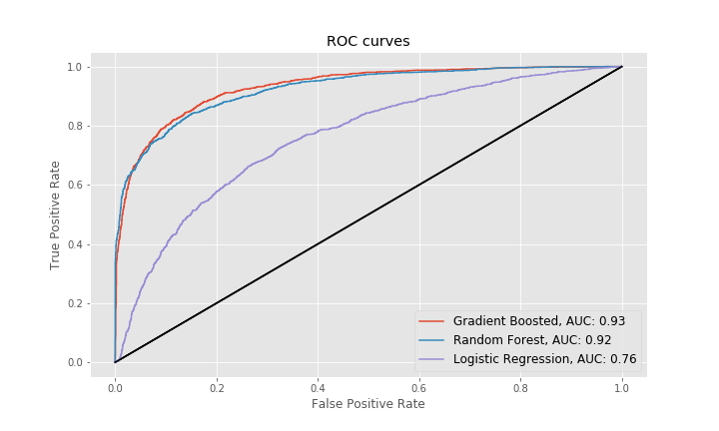
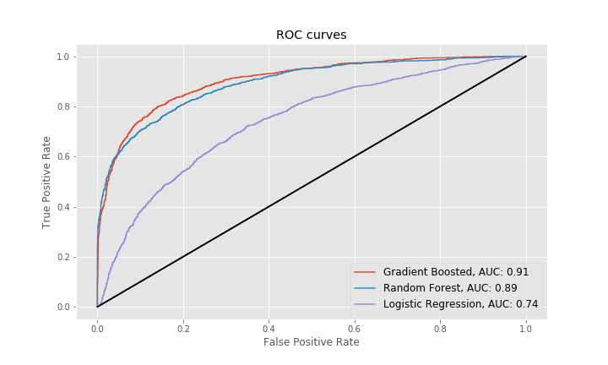
Temporal Summarization
Mean
Variance

Slide 8
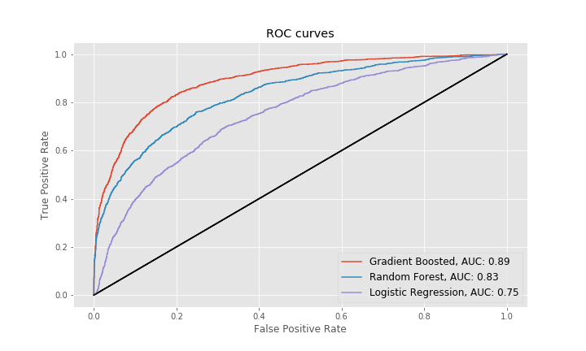
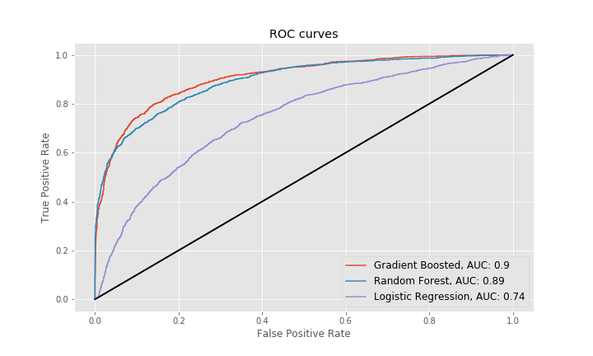
Frequency Summarization
Mean
Variance

Slide 9
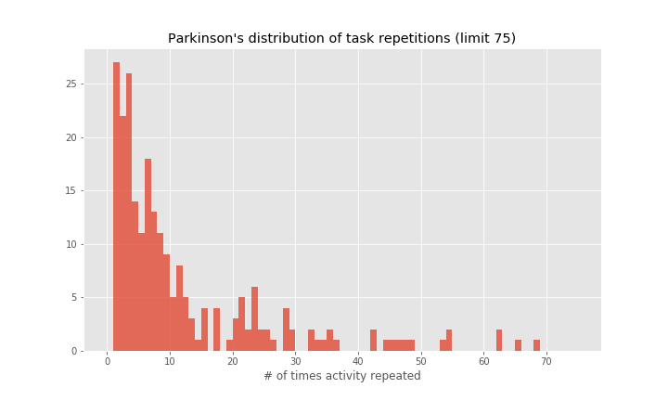
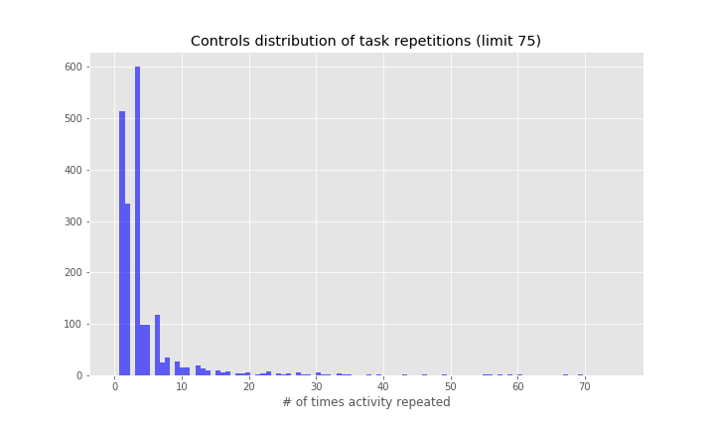
Identity Confounding

Slide 10
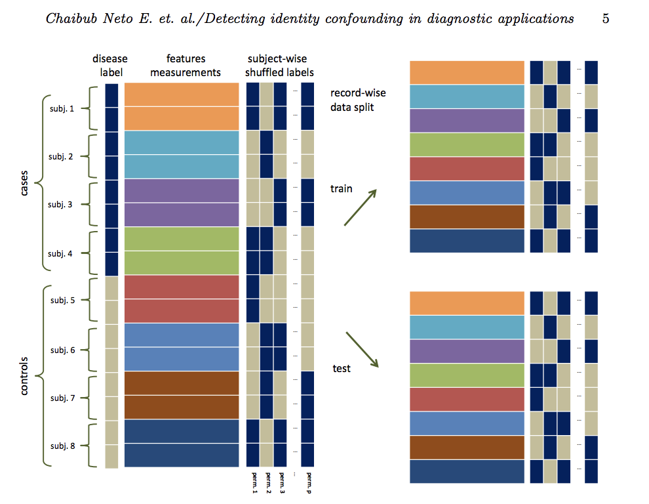
Method for Identifying Confounding

Slide 11
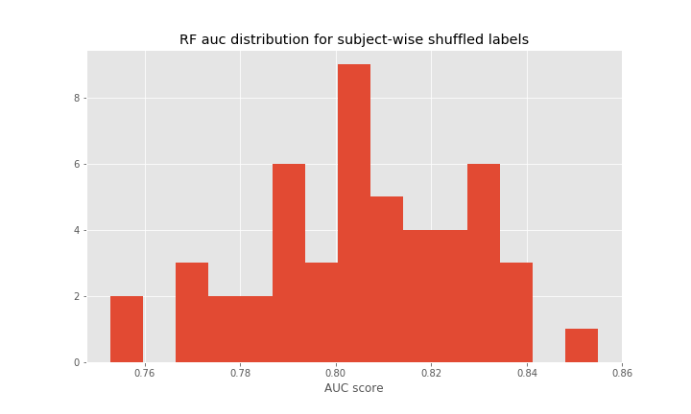
Identity Confounding
50 permutations

Slide 12
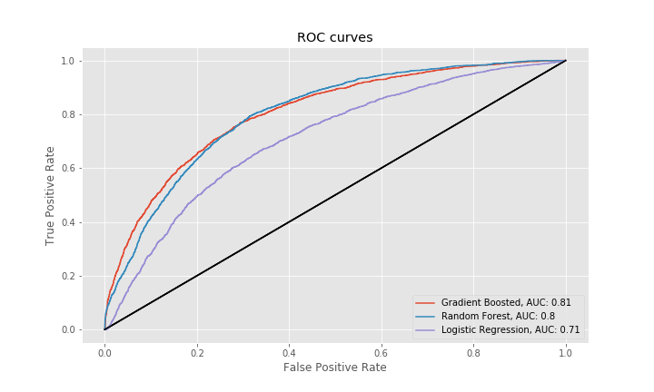
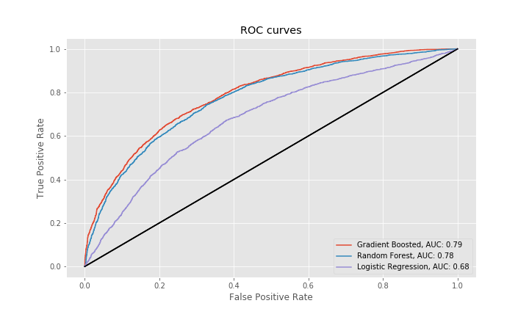
GroupKFold - Temporal Summarization
Mean
Variance

Slide 13
Conclusions
Results suggest differences in voice features can be detected between Controls and a Mild Stage Parkinson’s subgroup
Identity Confounding highlights the need for new strategies to help balance participation in mobile studies
Limitations
MDS - proxy for severity, no clinical validation provided
Future studies should provide clinical validation of severity

